Slide 1
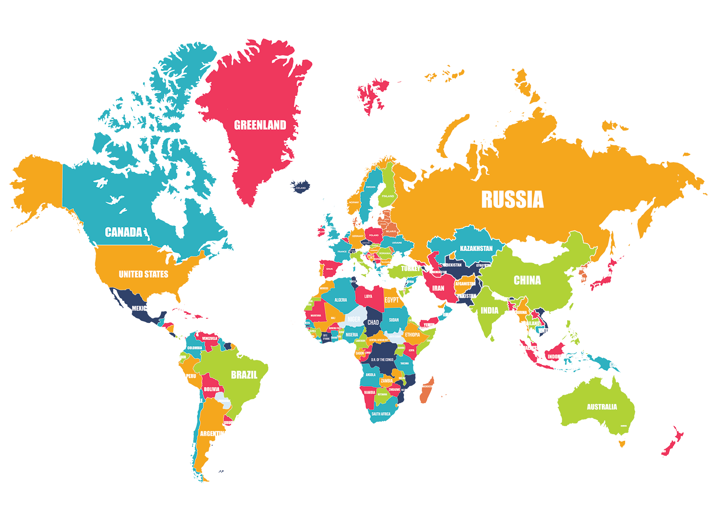
600 BCE- 600 CE
Madison, Gillian, Ben, Sean
Organization and Reorganization of Human Societies

Slide 2
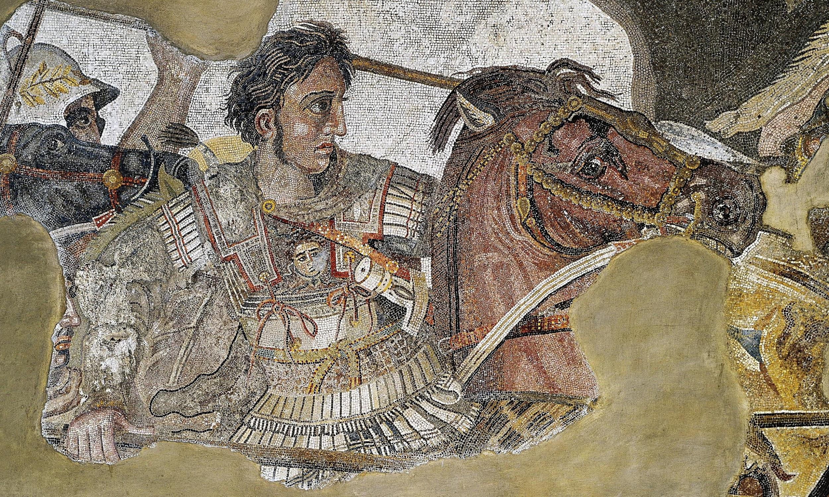
Alexander the Great
AP World Theme
  State-Building and forms of government
    Empires
Historiographical perspective
  Eurocentric
Alexander the Great formed the first empire to connect the european continent to asia.

Slide 3
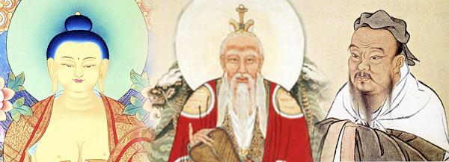
Confucianism, Buddhism, and Taoism
6th Century BCE
The rise of eastern religions created social structure in the societies of Eastern Asia including China, India, Tibet, Japan, and Korea.
AP World Theme: Development and Interaction of Cultures- The religions spread all over Asia creating an interaction of multiple cultures.
Historiographical Perspective: Before Christianity and European Dominance.

Slide 4
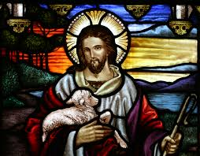
Beginnings of Christianity
Christianity began as a movement within Judaism. It initially began in Jerusalem and then continued to spread throughout the Middle East and Europe first being outlawed then endorsed by the Roman Empire.
AP World Theme #2 Development and interactions of cultures specifically religions.
The Historiographical Perspective
  Cultural History

Slide 5
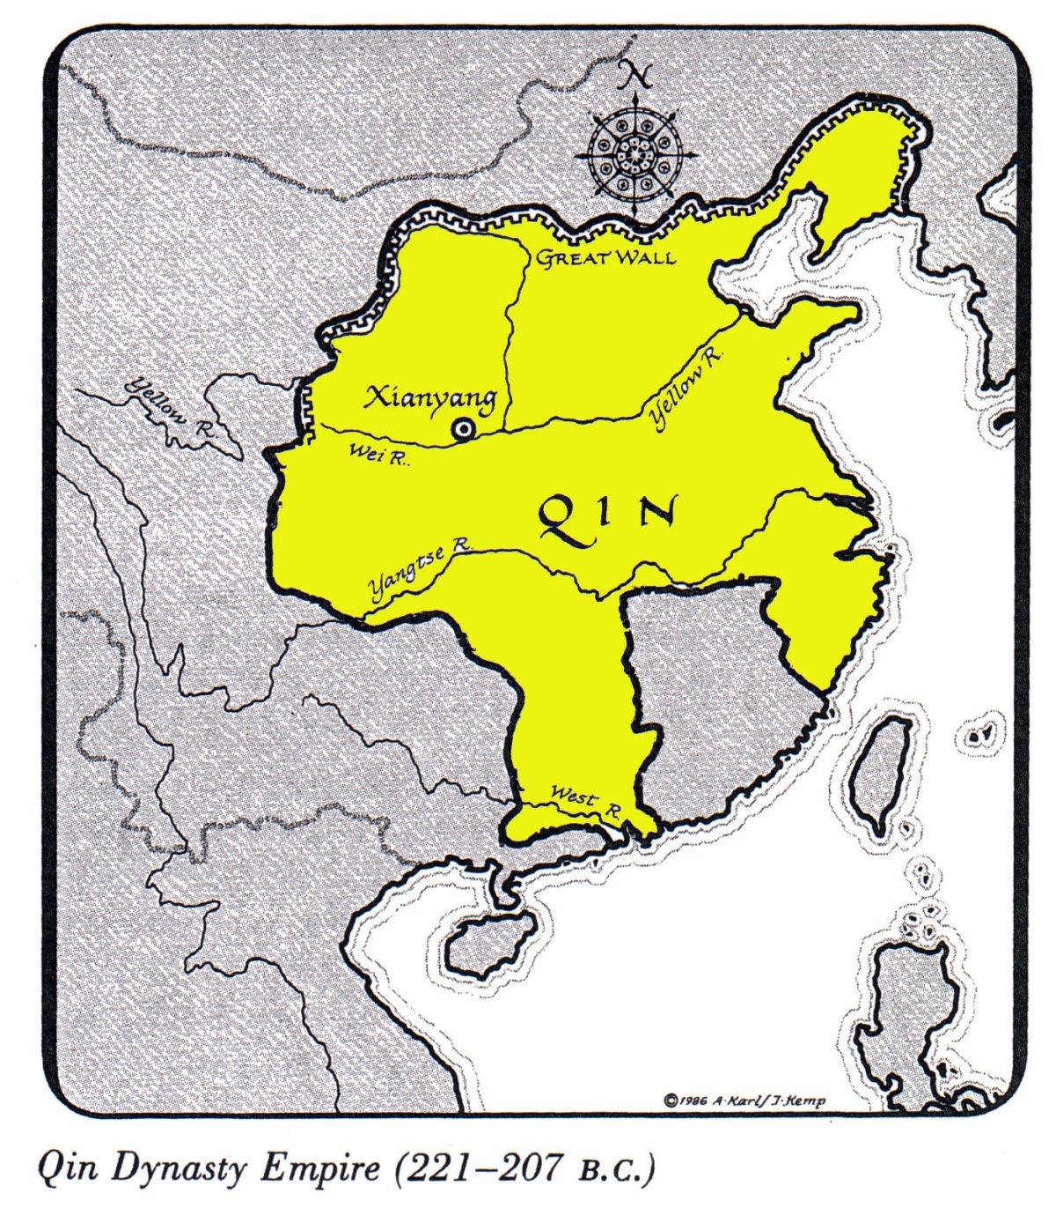
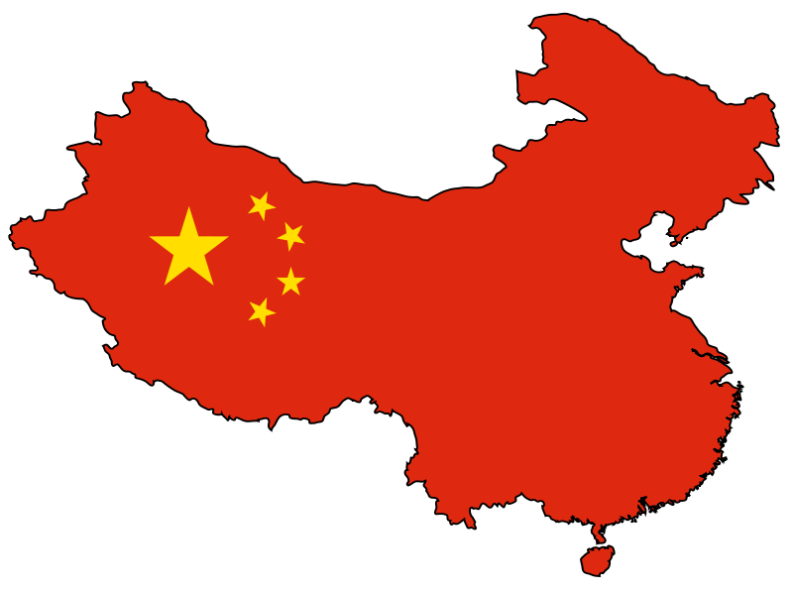
Qin Unified China
During the 200 BCE time period
Ruthlessness in battle and good leaders unified modern day China for the first time
AP World Theme #3, state-building and forms of government relate to this event because theme #3 has to do with empires, which the Qin was
This is a time period before European dominance and a lot of the interactions and developments happened within one society.

Slide 6
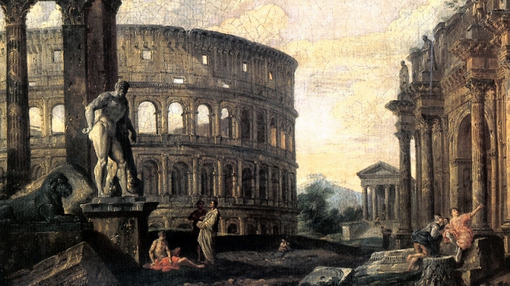
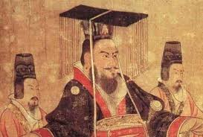
The Fall of Rome and the Han Dynasty
In 476 C.E. Romulus, the last of the Roman emperors in the west, was overthrown by the Germanic leader Odoacer, who became the first Barbarian to rule in Rome.
AP Theme #3
Historiographical Perspective:
Before dominant Europe. The Fall of Rome later brought the continent together and helped it become what it is today.
Dong Zhou, a war lord, killed all the eunuchs and burned the city of Luoyang to the ground. Battle after battle weakened the imperial order until Liu Xie who was finally abdicated in 220 CE, the year the Han Dynasty ended.
AP Theme #3
Historiographical Perspective
Before dominant Europe. The fall of this empire led to many more leadership powers and different empires.
Both of these falls of major empires and places led to the birth of something more modern that we still have today.

Slide 7
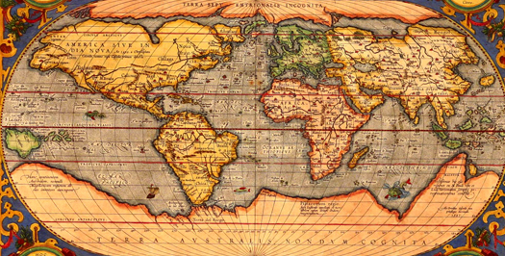
Summary
Beginning with Alexander the Great and ending with the Fall of Rome, we encapsulated the organization and reorganization of human societies, which is what the time period of 600 BCE to 600 CE is all about. Alexander the Great connected Europe and reorganized the continent. After that, the rise of Confucianism, Buddhism, and Taoism rose. These religions brought together much of the Asian continent by connecting everyone with three major religious beliefs. The beginnings of Christianity was similar to Asia, but with a different type of religion bringing everyone together. Qin unifying China speaks for itself. The Qin empire was the first thing that brought modern day China together as one organized society. The Fall of Rome and Han Dynasty, although different they relate to each other. Both had an effect on the fact that because of their downfall, they brought other places together as a reorganized area.

